Slide 1
BigData – Spark – Processing discover Spark Core & Sql
Arnaud Nauwynck – Nov 2023

Slide 2
Outline
Example RAW to LAKE transformations
Explanation step-by-step
Dataset
Parallel Distribution

Slide 3
Reminder: Spark RAW to LAKE samples

Slide 4
Typical RAW to LAKE as Spark Java code
Reminder
spark.read .format(« csv ») .option(«schema », « col1 type1, … colN typeN ») .load(« hdfs://raw/team/domain/table/date=2022-10-12 »)
.as(Encoder.bean(Bean.Class) .map(bean -> transformBean(bean) )
.toDF() .repartition(2, « col1 ») .sortWithinPartition(« col1, col2, col3 »)
.write .format(« parquet ») .save(« hdfs://lake/team/domain/table/date=2022-10-22 »);
read
transform
write

Slide 5
Typical RAW to LAKE processing with Spark as SQL code
Reminder
write
INSERT OVERWRITE
lake_team_domain.table SELECT /* +REPARTITION(col1, 2) */
col1, col2,
udf_func1(col3, col4) as col3,
udf_func2(col4, col5) as col4,
..
FROM
raw_team_domain.table
JOIN
lake_anotherTeam_domain.anotherTable x ON x.ID=id
WHERE date=‘2022-10-22’ AND ..
SORT BY col1, col2, col3 -- idem sortWithinPartition
transform
read
transform
read
write

Slide 6
Example of LAKE Aggregation
Reminder
INSERT OVERWRITE
lake_team_domain.table SELECT * FROM (
SELECT * FROM table1 WHERE ..
UNION
SELECT * FROM table2 WHERE ..
UNION
SELECT * FROM table3 WHERE ..
UNION
SELECT * FROM table4 WHERE ..
)
SORT BY col1, col2, col3 -- idem sortWithinPartition

Slide 7
Example of « latest value » cristalisation analytical query « over(partition by) »
Reminder
INSERT OVERWRITE
lake_team_domain.table SELECT
col1,col2,…. colN -- idem * EXCEPT rank (cf issue SPARK-33164)
FROM (
SELECT *,
RANK() OVER (PARTITION BY id ORDER BY update_time DESC) as rank
FROM lake_team_domain.event_table
)
WHERE rank=1
SORT BY col1, col2, col3 -- idem sortWithinPartition

Slide 8
Step-by-Step explained

Slide 9
Typical RAW to LAKE as Spark Java code
Reminder
spark.read .format(« csv ») .option(«schema », « col1 type1, … colN typeN ») .load(« hdfs://raw/team/domain/table/date=2022-10-12 ») .as(Encoder.bean(Bean.Class) .map(bean -> transformBean(bean) )
.toDF()
.repartition(3, « col1 ») .sortWithinPartition(« col1, col2, col3 »)
.write .format(« parquet ») .save(« hdfs://lake/team/domain/table/date=2022-10-22 »);
read
Step 1/4
transform
Step 2/4
Step 3/4
write
Step 4/4

Slide 10


RAW to LAKE – Step 1/4: read to Dataset
Dataset<Row> ds = spark.read .format(« csv ») .option(«schema », « col1 type1, … colN typeN ») .load(« hdfs://raw/team/domain/table/date=2022-10-12 »)
read
Input = Files (scanned from Directory)
Distributed Read from Storage
Result = Distributed Parts in-memory

Slide 11

RAW to LAKE – Step 2/4 : Transform Dataset
transform
Dataset<Row> ds2 = ds.map(row -> transformData(row) )
Distributed Processing to compute each new part

Slide 12
RAW to LAKE – Step 3/4 : Repartition Dataset
Dataset<Row> ds3 = ds2 .repartition(2, « col1 ») .sortWithinPartition(« col1, col2, col3 »)
transform
Network Shuffle to distribute / group / sort data

Slide 13
RAW to LAKE – Step 4/4 : Write Dataset
ds3.write
.fomat(« parquet »)
.save(« hdfs://lake/trig/domain/table »)
write
Distributed Write Dataset to Storage

Slide 14


How it works ?

Slide 15
Zooming more ..

Slide 16
RAW to LAKE – Step 1/4: read to Dataset
??
???????
??
??
Input = Files from Distributed Storage
Result = Distributed Parts in-memory
??
How to Assign N x Files – P x blocks ⬄ to Q x Executors ??
+ Retry on Error ?? + Communicate more ??

Slide 17


Analogy : How to play music ? ( N musicians without 1 Conductor != 1 Orchestra )
spark-driver
spark-executors

Slide 18
Read N Files – assign Tasks to Executors
(5) Send tasks progress/status
(4) exec read task
N Files
(2) read N files
metadata
(3) Send tasks to executors
Task_i = « read file_j »
(1) Directory List files
spark-driver
spark-executors

Slide 19

Remark [1/2] on Parallelism only 1 File -> only 1 Task
(4) exec read task
1 File
(2) read file
metadata
(3) Send task to executors
Task_i = « read file_j »
(1) Directory List files
spark-driver
spark-executors

Slide 20
Remark [2/2] on Parallelism Splittable File format (parquet).. Like dir
N x Blocks (usually 256 Mo)
independent, read at offset
offsets
…Like dir
File metadata
= schema + N blocks infos (offset + stats)
1 splittable file

Slide 21
Zooming RAW to LAKE – Step 2/4 : Transform Dataset
transform
Dataset<Row> ds2 = ds.map(row -> transformData(row) )
???????
Distributed Processing to compute each new part

Slide 22

WholeStageCodeGen
Program
= Dataset instructions
(3) Send task + bytecode
to spark-executors
Generate java code (RDD Spark sub-class « WholeStageCodeGen$i »)
(2) Compile Bytecode
(4) Execute tasks

Slide 23
Advanced Transform … using Row -> Java ->map()-> Java -> Row
ds.as( Encoders.bean(InputBean.class) )
.toDF()
transform
class InputBean {
…
}
class OutputBean {
…
}
OutputBean transformBean(InputBean b) { // complex transform in java
return new OutputBean(… );
}

Slide 24
Explained as().map().toDF()
Dataset<Row> ds = …
// convert Row->Bean
Dataset<InputBean> dsInputBean =
ds.as(Encoder.bean(InputBean.class))
// map
Dataset<OutputBean> dsOut = dsInputBean.map(bean -> transformBean(bean) )
// convert OutputBean -> Row
Dataset<Row> df = dsOut.toDF();
ds.as( Encoders.bean(InputBean.Class) ) .map(bean -> transformBean(bean) )
.toDF()

Slide 25

Converting Tabular SQL Row to Java Beans
CREATE TABLE MyTable (
field1 Int,
field2 String
)
public class MyBean {
public int field1;
public String field2;
}
encoder = Encoders.bean(MyBean.class)
df.as(encoder)
Dataset<Row> df = …
Dataset<MyBean> ds = …
Object[0]
Object[1]
ds.toDF()
Object[2]

Slide 26
RAW to LAKE – Step 3/4 : Repartition Dataset
transform
Dataset<Row> ds3 = ds2 .repartition(2, « col1 ») .sortWithinPartition(« col1, col2, col3 »)
???????
Network Shuffle to distribute / group / sort data

Slide 27
What if a Spark-Executor crash / Node stop ?
block storage
Shuffle-service
???????
Recompute/recover lost blocks
From mem or disk
…using ShuffleService + storage
after shuffle operation,
=> Replicate (peer-to-peer)
/ Persist Blocks (mem and/or disk)
…using ShuffleService + storage

Slide 28
Example usage: repartition(N).map( .. ).repartition(1)
INNEFFICIENT !!!
Undistributed
/ Badly Skewed Data
repartition(N)
EFFICIENT
repartition(1)
Avoid too many small files

Slide 29
Example transformation … in SQL

Slide 30
Typical RAW to LAKE as Spark SQL
Reminder
write
INSERT OVERWRITE
lake_team_domain.table SELECT /* +REPARTITION(col1, 2) */
col1, col2,
udf_func1(col3, col4) as col3,
udf_func2(col4, col5) as col4,
..
FROM
raw_team_domain.table
JOIN
lake_anotherTeam_domain.anotherTable x ON x.ID=id
WHERE date=‘2022-10-22’ AND ..
SORT BY col1, col2, col3 -- idem sortWithinPartition
transform
read
transform
read
write

Slide 31


Explained … SQL (-> Files) -> Dataset
SELECT ..
FROM
raw_team_domain.table
read
Scan Files
In Directory
Table = Directory
+ schema
Metastore
Input = SELECT .. from SQL Table

Slide 32

(Hive) MetaStore
Store ONLY metadatas (DDL + partitions)
Mapping SQL – Dirs+Files
DDL:
CREATE EXTERNAL TABLE students (
socialSecuId: Int,
firstName string, lastName string,
birth: Date, …
) PARTITIONED BY (promo: Int)
STORED AS parquet
LOCATION ‘hdfs://lake/students’

Slide 33
Location Dir + Partitions
« / » = root hdfs://host/
« /lake » (dir)
« /students » (table storage dir)
« /promo=2021 » (partition dir)
« /promo=2022 » (partition dir)
« file1.parquet» (data file)
« file2.parquet» (data file)

Slide 34
Dataset -> INSERT SQL Table (-> Files)
write
INSERT OVERWRITE
lake_team_domain.table
Write Files (append/overwrite)
To Directory
Table = Directory
+ schema
Metastore
Output
SQL: INSERT INTO/OVERWRITE Table

Slide 35
More Java <-> Sql Interactions

Slide 36

Executing SQL from Java
for( int i = 0; i < 10; i++) {
String sql = « SELECT * from db.table » + i;
Dataset[Row] ds = spark.sql(sql);
..
}
NO imperative in SQL (cf PL/Sql extensions)
=> OK in java code : if, for(), …

Slide 37
Java DataSet as SQL View
Dataset[Row] ds = ..
ds.createTemporaryView(« myview1 »)
spark.sql(« SELECT * FROM myview1 »)

Slide 38
Calling Java from SQL : User-Defined Function
SELECT .. udf_func1(col3, col4) as col3,
udf_func2(col4, col5) as col4,
transform
int func1(int x, int y) { return x+y; }
spark.udf().register(« udf_func1",
(UDF2<Integer,Integer, Integer>) ::func1,
DataTypes.IntegerType);

Slide 39

Spark = Unified Sql-Files-Java
Dataset / RDD
Files

Slide 40


Spark : Unified Engine (Distributed Storage, Distributed Compute)
Compute Library
Distributed Storage
Distributed Compute
RDD (API)
Files
(parquet, ..)
RDD is an abstract class API
=> Can plug any User-Defined implementations

Slide 41

Dataset API …. SQL Extensions
Dataset<T>
Dataset<Row>
RDD
Column API
Expression API
(operator overload)
encoder
Lamba /Function
+ runtime compile to bytecode
( WholeStageCodeGen )

Slide 42


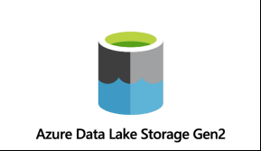


More Extensions: Hadoop FileSystem API
HDFS implements FileSystem
Distributed Storage API
java.io.File
adapter
abstract class FileSystem {
..read, write, list,
}
More adapters
….
Spark rely on API
=> Can plug any implementations

Slide 43



More Extensions: Cluster Scheduler API
Cluster Manager
Scheduler API
TaskScheduler (SPI)
abstract class TaskScheduler {
..start,stop, submitTasks,cancelTasks,
notify Host-Executor-Task changes
}

Slide 45

More « Extensions » backport API to other Langages (Python, R)
class DataFrame:
… hundred methods …
def method123 (self, x) -> Y
self._jdf.method(x, self.sparkSession)
API
API
public class Dataset {
… hundred methods …
public Y method123 (X x) {
… internals sparkContext…
}
py4j
from py4j.java_gateway import JavaObject
from subprocess import Popen from pyspark.context import SparkContext
..
pid = Popen(« spark-submit » …)
Socket(.. )
SparkContext

Slide 46


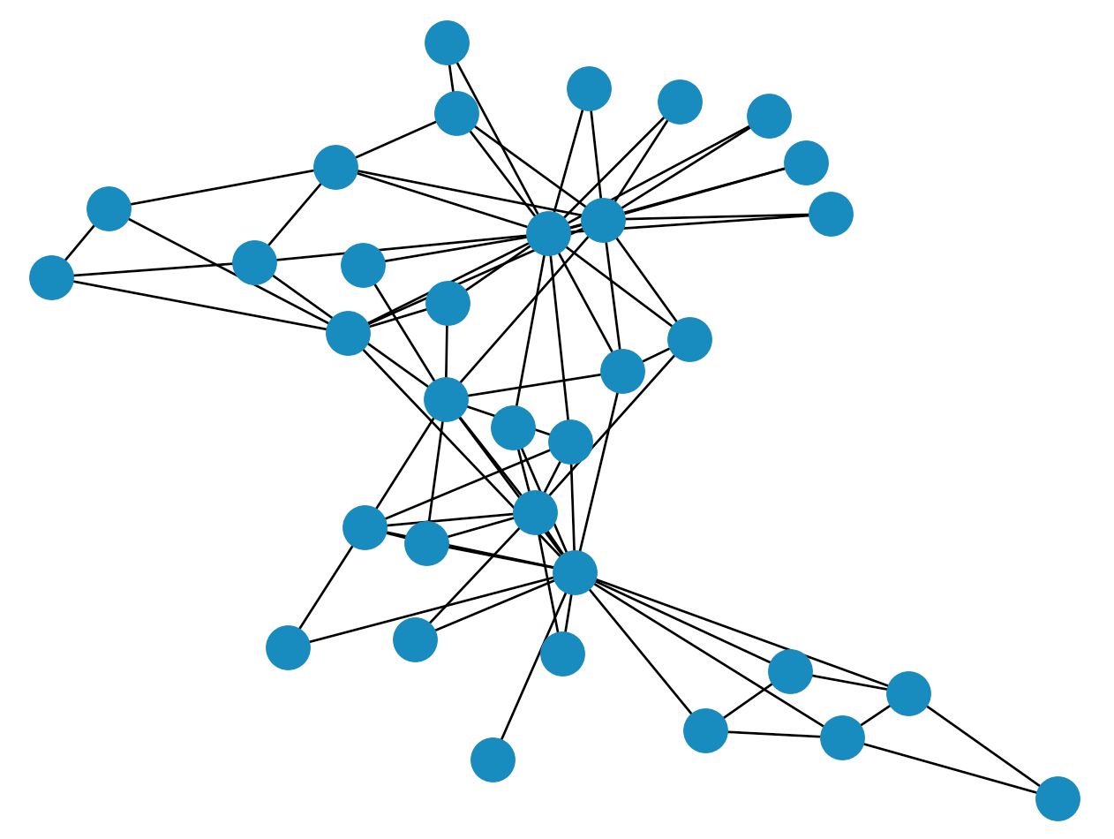



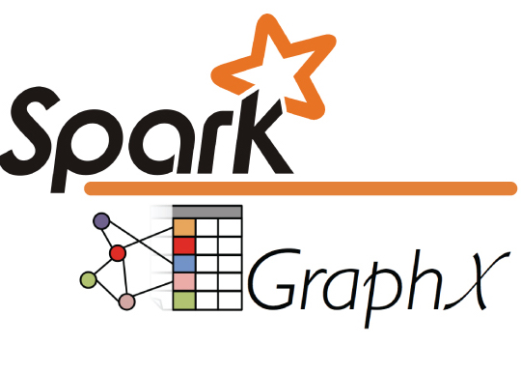


Spark-Core + …
Structured Data
Modules
DataSource Connectors
(Hadoop API)
Cluster Manager
Core
Langages Support

Slide 47
What are Dataset/RDD ? How they work ?

Slide 48
DataSet ~ Set of <Data>
Dataset<UserDefinedClass>
Dataset<Row> = « DataFrame »
Object[0]
Row
Row
Object[1]
Object[2]
Row
Internal RDD

Slide 49
DataSet = sql view for RDD
module spark-sql
class org.apache.spark.sql.Dataset
Sql
module spark core
class org.apache.spark.rdd.RDD
Core

Slide 50
RDD = ?
Resilient
Distributed
Dataset
Resist to failure
Horyzontal scale

Slide 51
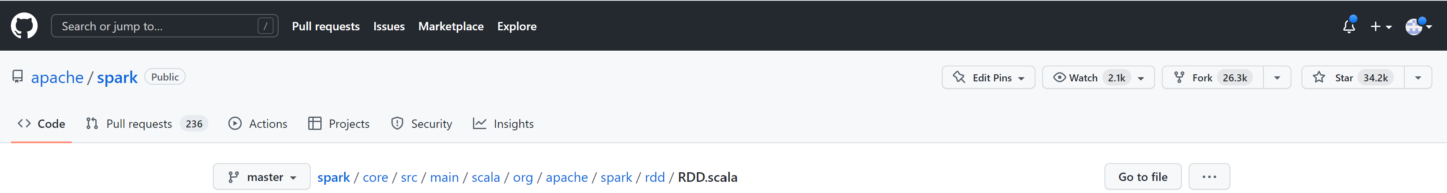
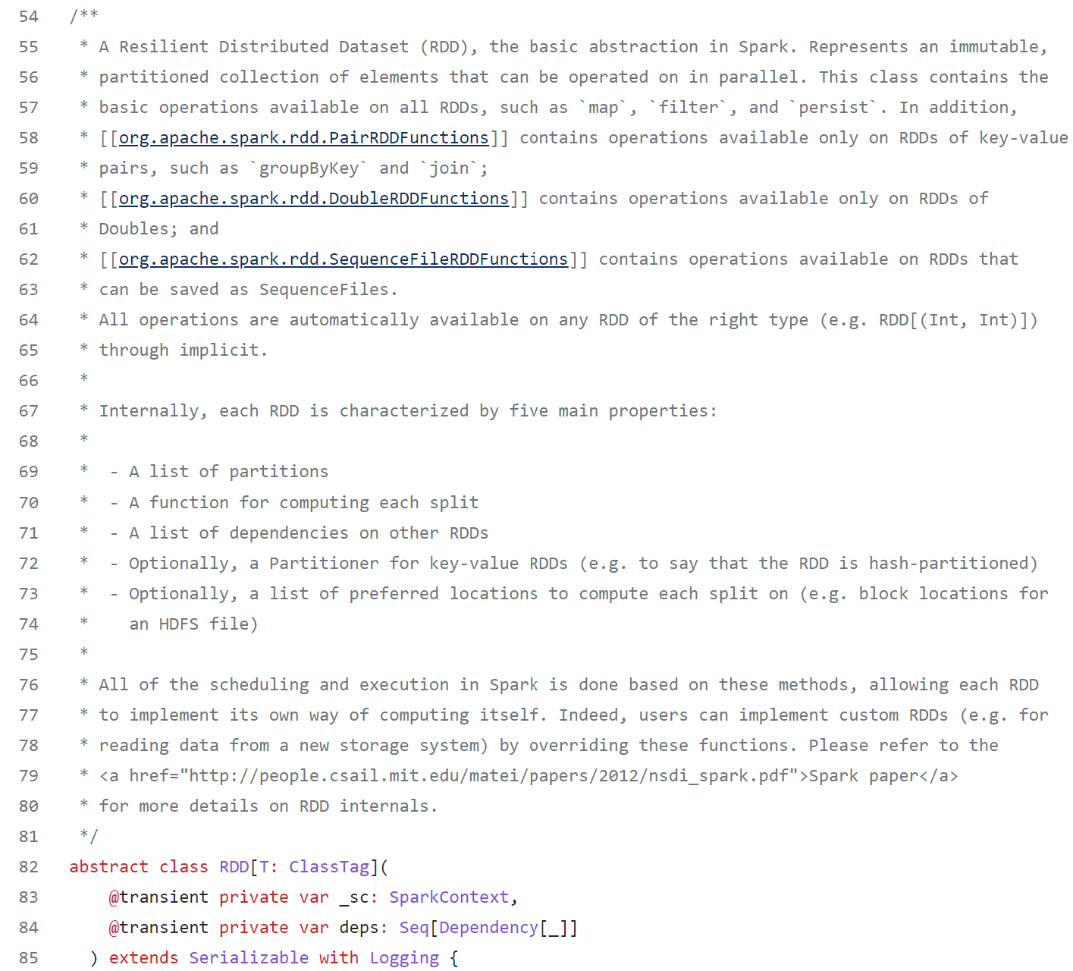
RDD source doc

Slide 52
RDD Doc (1/3)
A Resilient Distributed Dataset (RDD),
the basic abstraction in Spark.
Represents
an immutable,
partitioned collection of elements
that can be operated on in parallel.
This class contains the basic operations available on all RDDs,
such as `map`, `filter`, and `persist`.
In addition, PairRDDFunctions (..) of key-value pairs,
(..contains) `groupByKey` and `join` (..)

Slide 53
RDD Doc (2/3)
Internally, each RDD is characterized by :
- A list of partitions
- A function for computing each split
- A list of dependencies on other RDDs
- Optionally, a Partitioner
- Optionally, a list of preferred locations

Slide 54
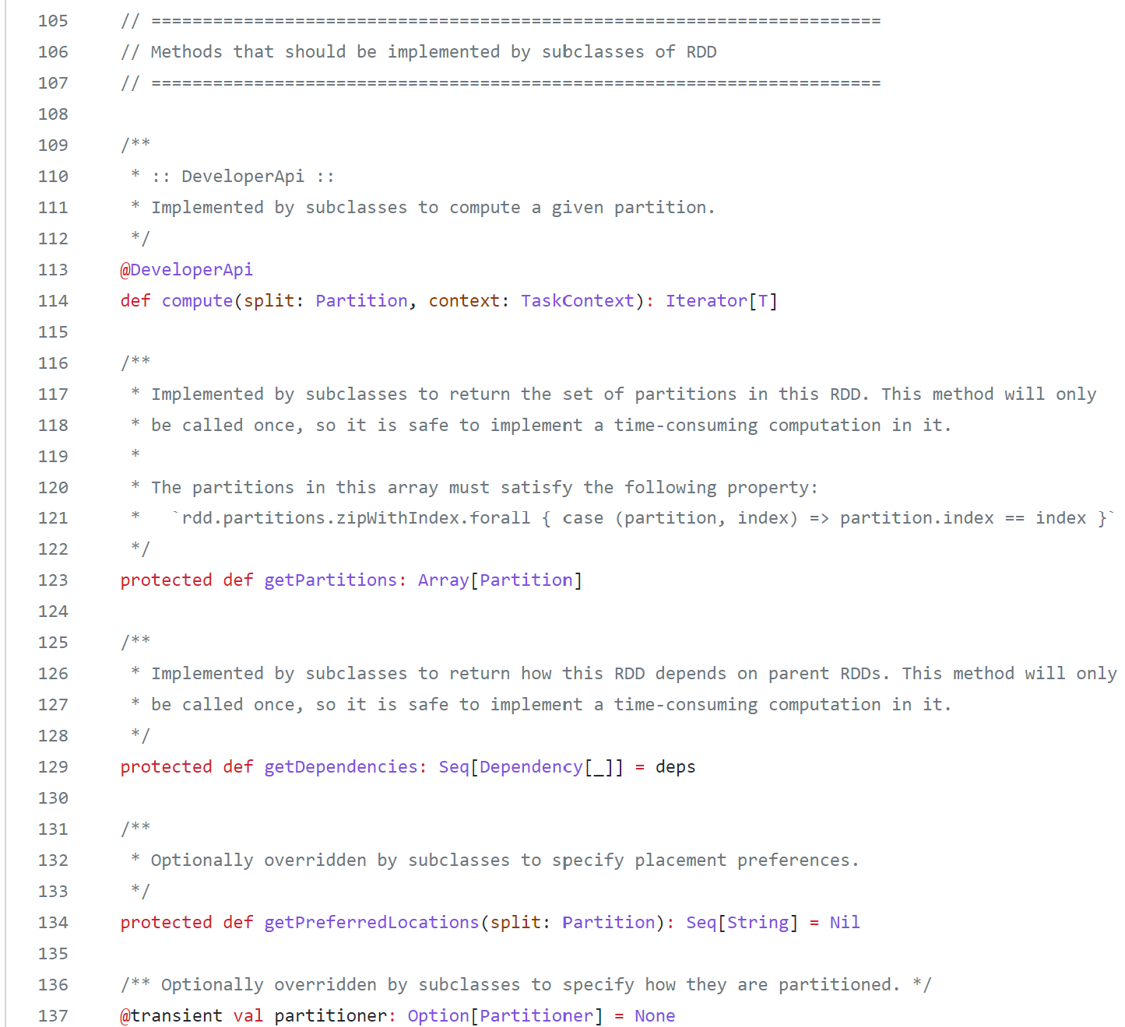
RDD Abstract methods

Slide 55
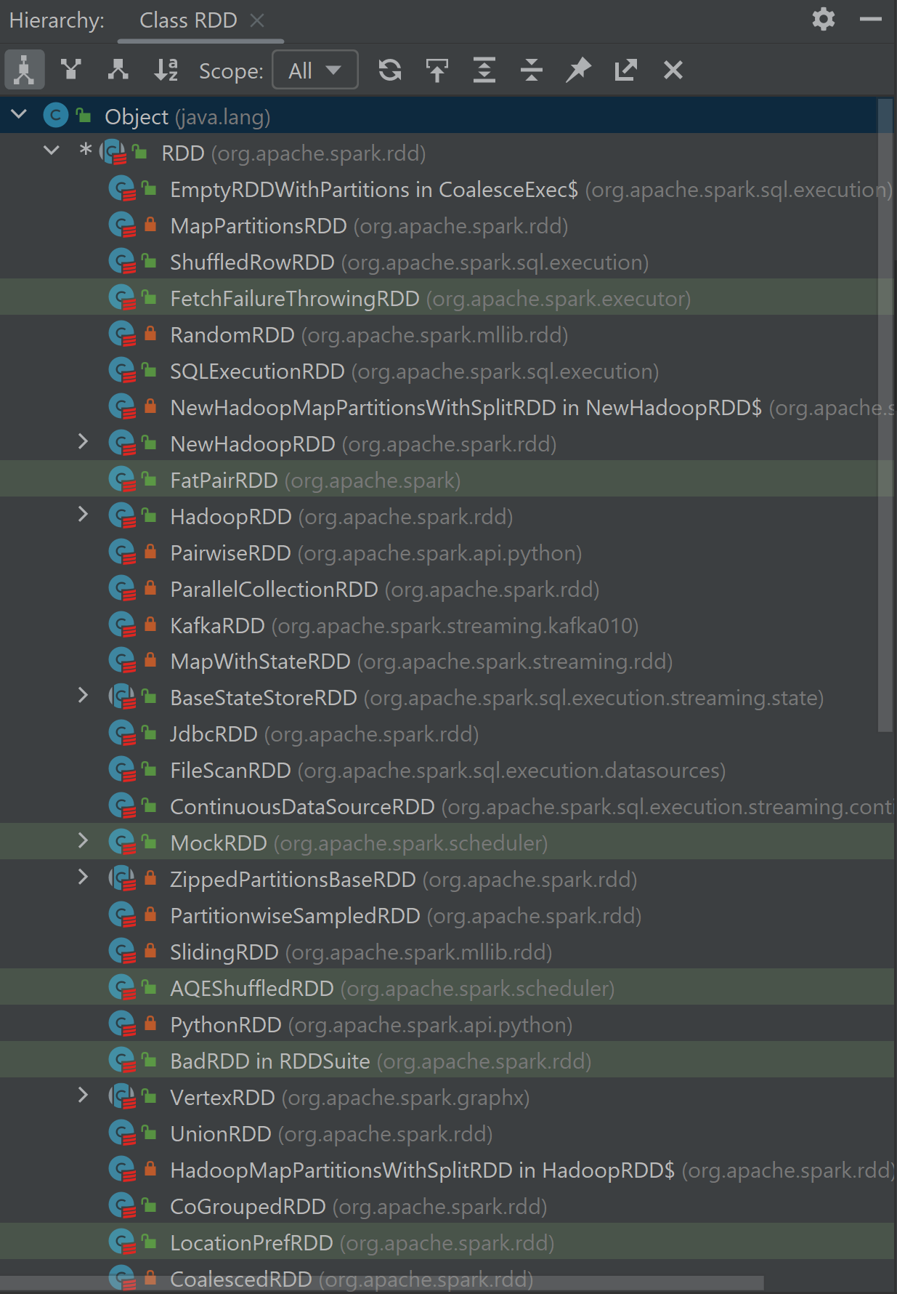
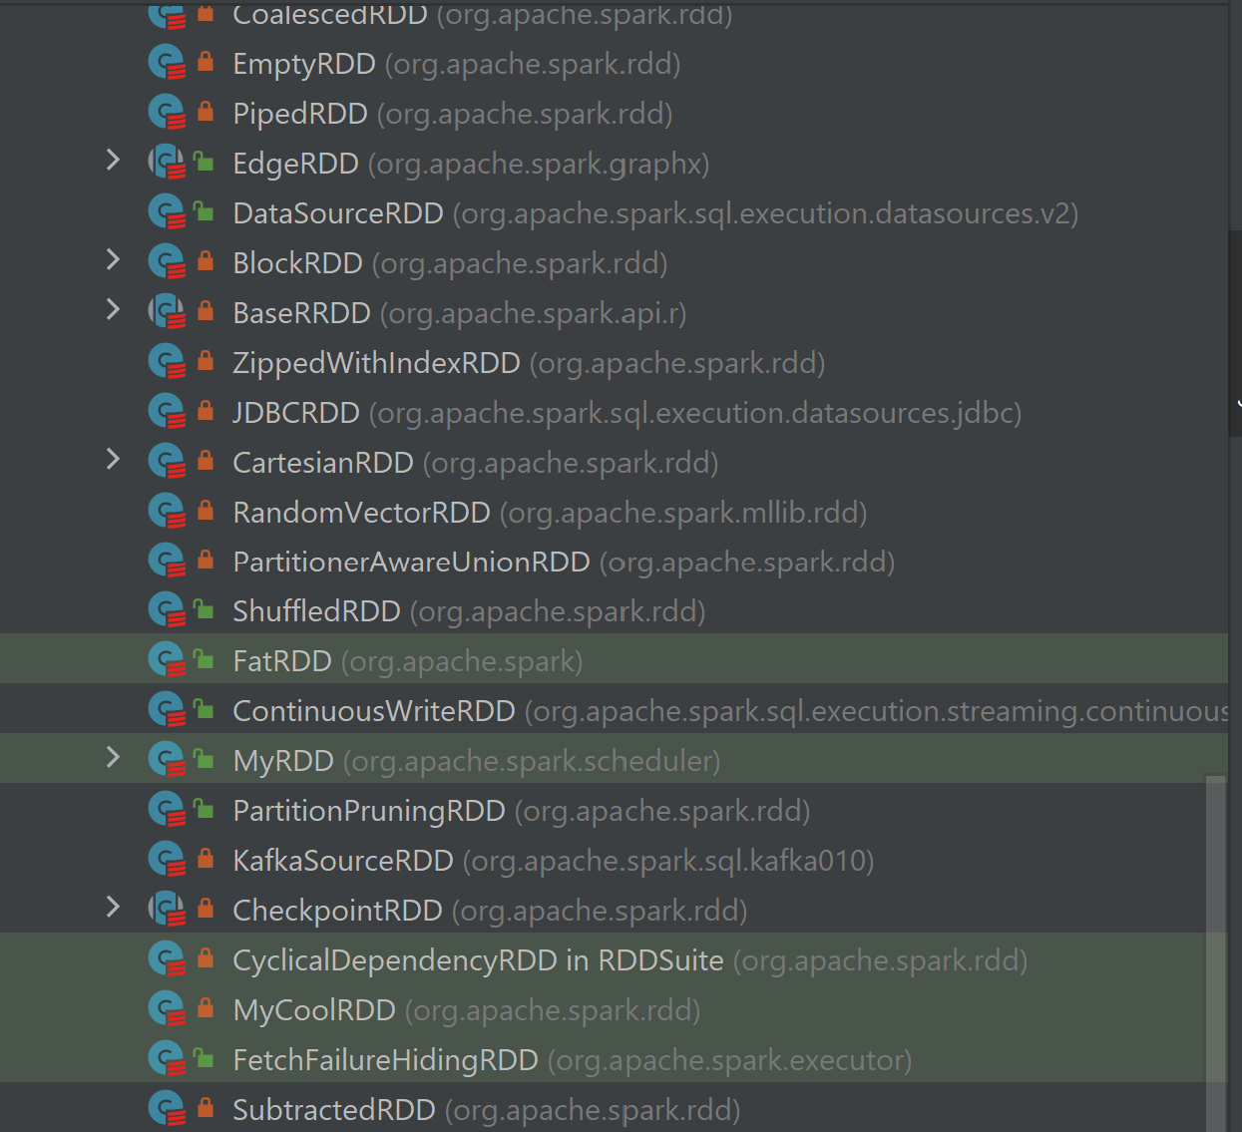
Abstract RDD class => (many) concrete sub-classes

Slide 56
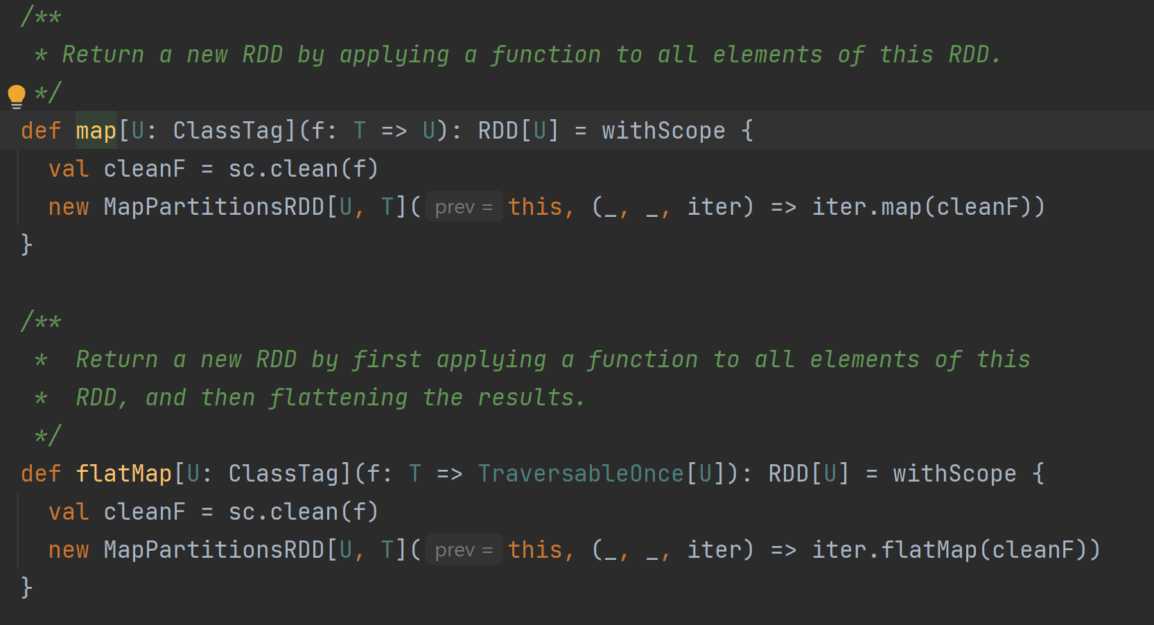
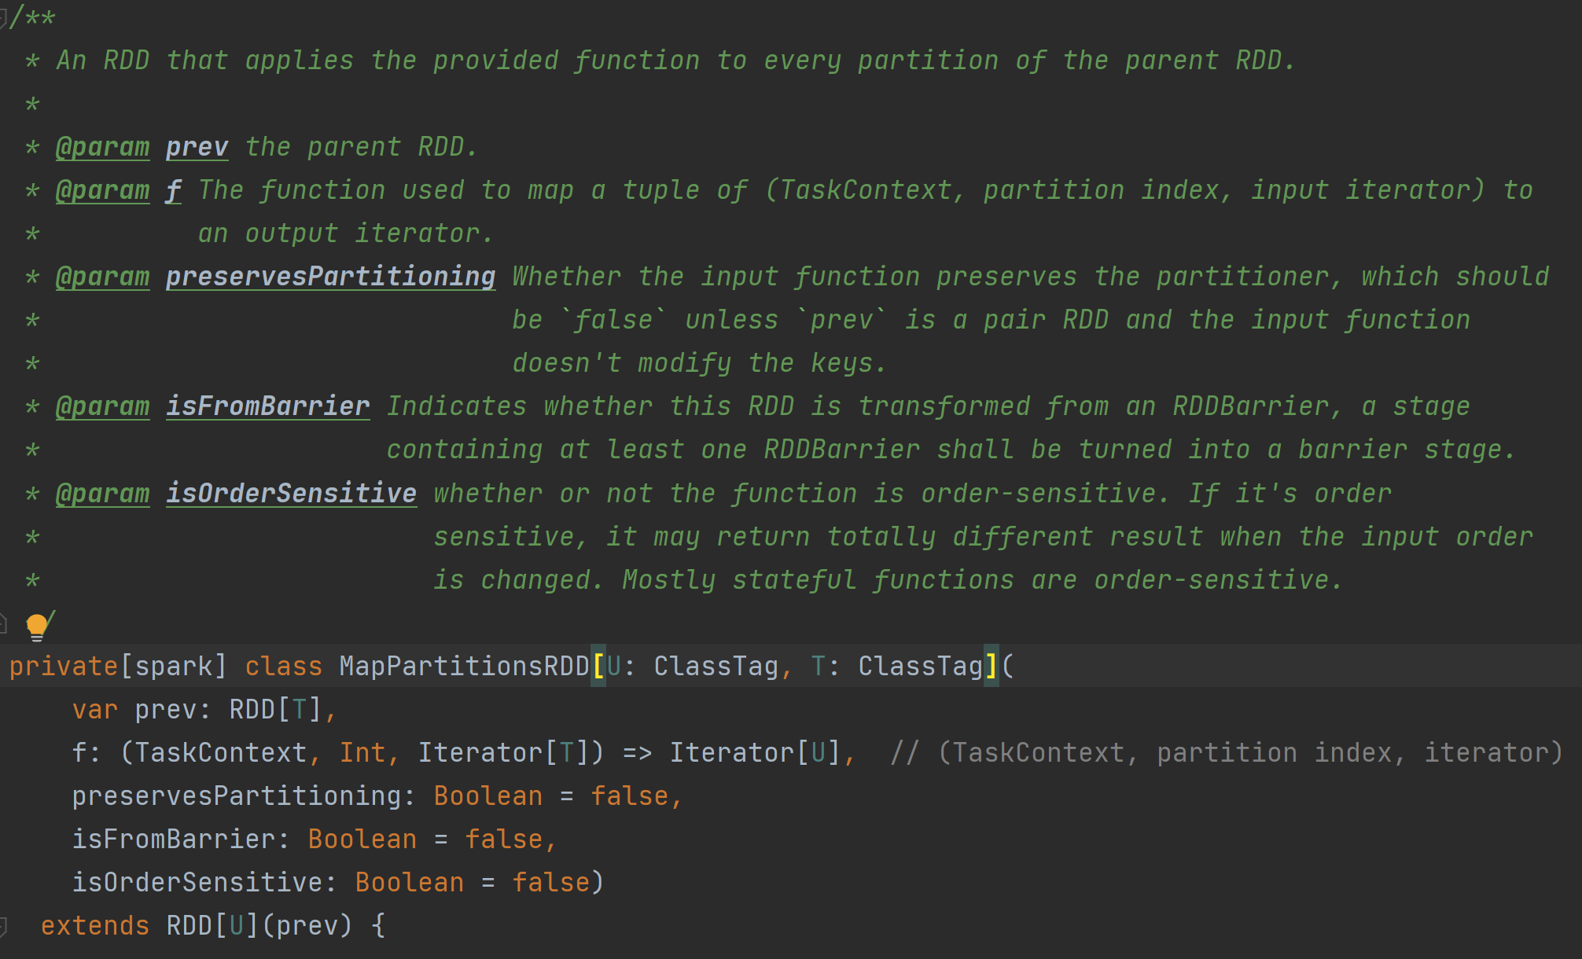
1 algorithm / transformation => 1 RDD Sub-class
Example: rdd.map( func ) or rdd.flatMap( func )

Slide 57
Call transform function => Create new RDD (linked)
RDD 1
RDD rdd1 = … read
RDD rdd2 = rdd1 .map( .. )
RDD rdd3 = .. read
RDD rdd4 = rdd2 .join( rdd3 )
dependency
RDD 2
= func( RDD1 )
dependencies
RDD 3
RDD 4
= func(
RDD2, RDD3 )

Slide 58
Call compute() => … dependency.compute()
RDD 1
(3) : rdd1.compute()
RDD 2
= func( RDD1 )
(2b) : rdd2.compute()
(2a) : rdd3.compute()
RDD 3
RDD 4
= func(
RDD2, RDD3 )
(1) : rdd4.compute()

Slide 59
RDD Dependencies : DAG (Directed Acyclic Graph)
Data propagation
RDD 1
RDD 2
= func( RDD1 )
Computation
dependency
RDD 4
= func(
RDD2, RDD3)
RDD 3
RDD Init
(example: .read() )
Terminal Result
(example: .count() )
Transformation DAG

Slide 60
3 equivalent formalisms: SSA create Api, Expression Algebra, DAG
SSA = Single State Assignments RDD API
Expression Algebra, Sql
SELECT map(t1) FROM Table1 t1 JOIN Table2 t2 on ..
RDD rdd1 = … read
RDD rdd2 = rdd1 .map( .. )
RDD rdd3 = .. read
RDD rdd4 = rdd2 .join( rdd3 )
new JoinRDD( new MapRDD( readRDD(table1) ),
readRDD(table2)
)
DAG

Slide 61
RDD Doc (3/3)
All (..) in Spark is done based on these methods,
allowing each RDD to implement its own way of computing itself.
Indeed, users can implement custom RDDs
(e.g. for reading data from a new storage system)
by overriding these functions.
Please refer to the
<a href="http://people.csail.mit.edu/matei/papers/2012/nsdi_spark.pdf">Spark paper</a>
for more details on RDD internals.

Slide 62
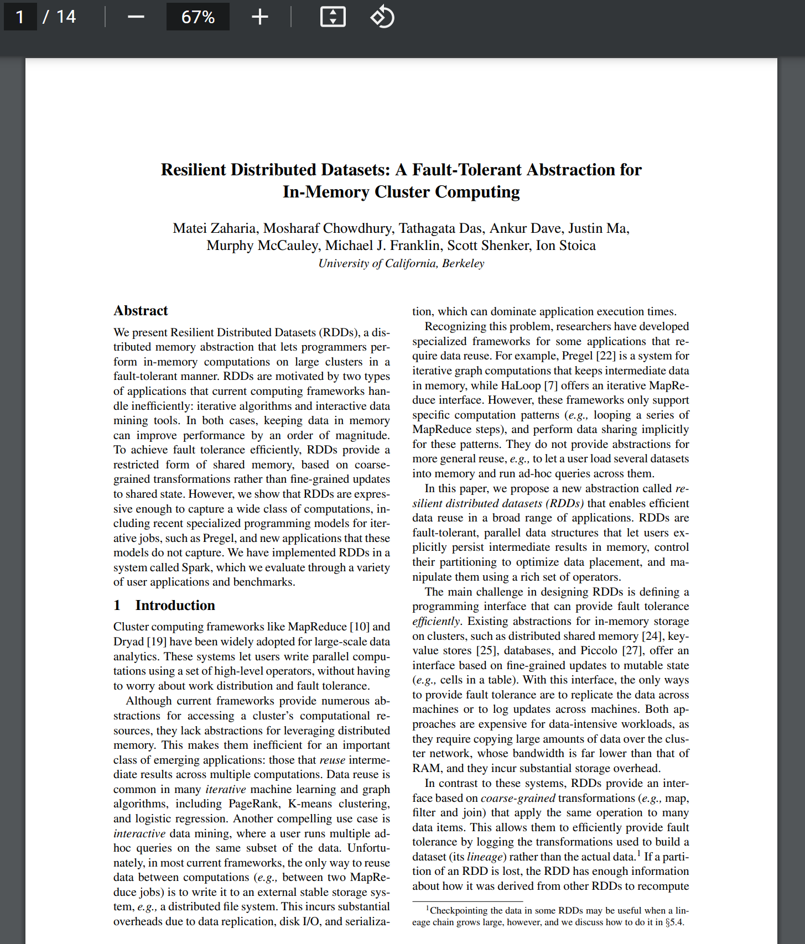
RDD Paper
A Fault-Tolerant
Abstraction
For In-Memory Cluster
computing
To achieve fault tolerance efficiently,
RDDs provide a restricted form of shared memory,
based on coarse-grained transformations

Slide 63
Fault Tolerant - Computation
Option 3: recompute dependency sources
Option 2: find sources dependency backup Copy (on different server / storage)
Lost ?
Option 1: retry-compute (on same server)
Lost ?
Crash ?

Slide 64
CoarseGrain … Scheduler/Executer
Spark-driver
Implements Fault Tolerance+Distribution
… internally called « CoarseGrainScheduler »
Spark-executor
Implements task main loop
… internally called « CoarseGrainExecutor »
CoarseGrain
partition
= unit of caching/ recomputation
(all elements or nothing)

Slide 65
DataSet : Collection of Objects, parallelize 1 CPU per partition

Slide 66
Distribution: Partition < Executor < Node
Worker node
Worker node
Worker node
Spark executor
Spark executor
Spark executor
Partition 1
Partition 3
Partition 5
Spark executor
Partition 6
Partition 7
Worker node
Partition 4
Partition 8
Partition 9
Partition 10
Spark executor
Partition 2
Several spark-executor
processes per nodes
Several partitions
Per spark-executor
several worker nodes

Slide 67

Optimize parralelism: Adapt partitions to number of Cores
Spark-executor: 1 partition << N cores
Spark executor: N partitions >> few cores
Spark executor: N partitions ~ N cores

Slide 68
Skewed Data … need Repartitioned equally
Target: move each row[i] to node[j] j = « rowId modulo N »

Slide 69
« Narrow » / « Wide » Transformations
narrow
Wide (shuffle)

Slide 70
RDD … OK so What is a Dataset ?

Slide 71
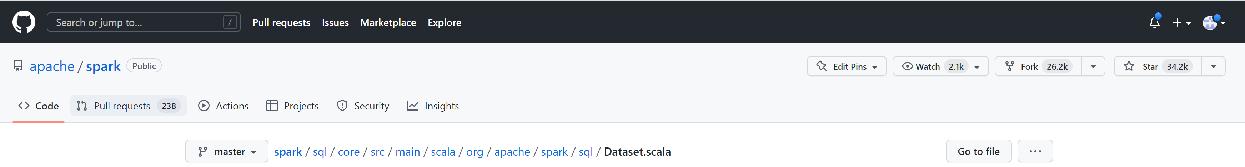
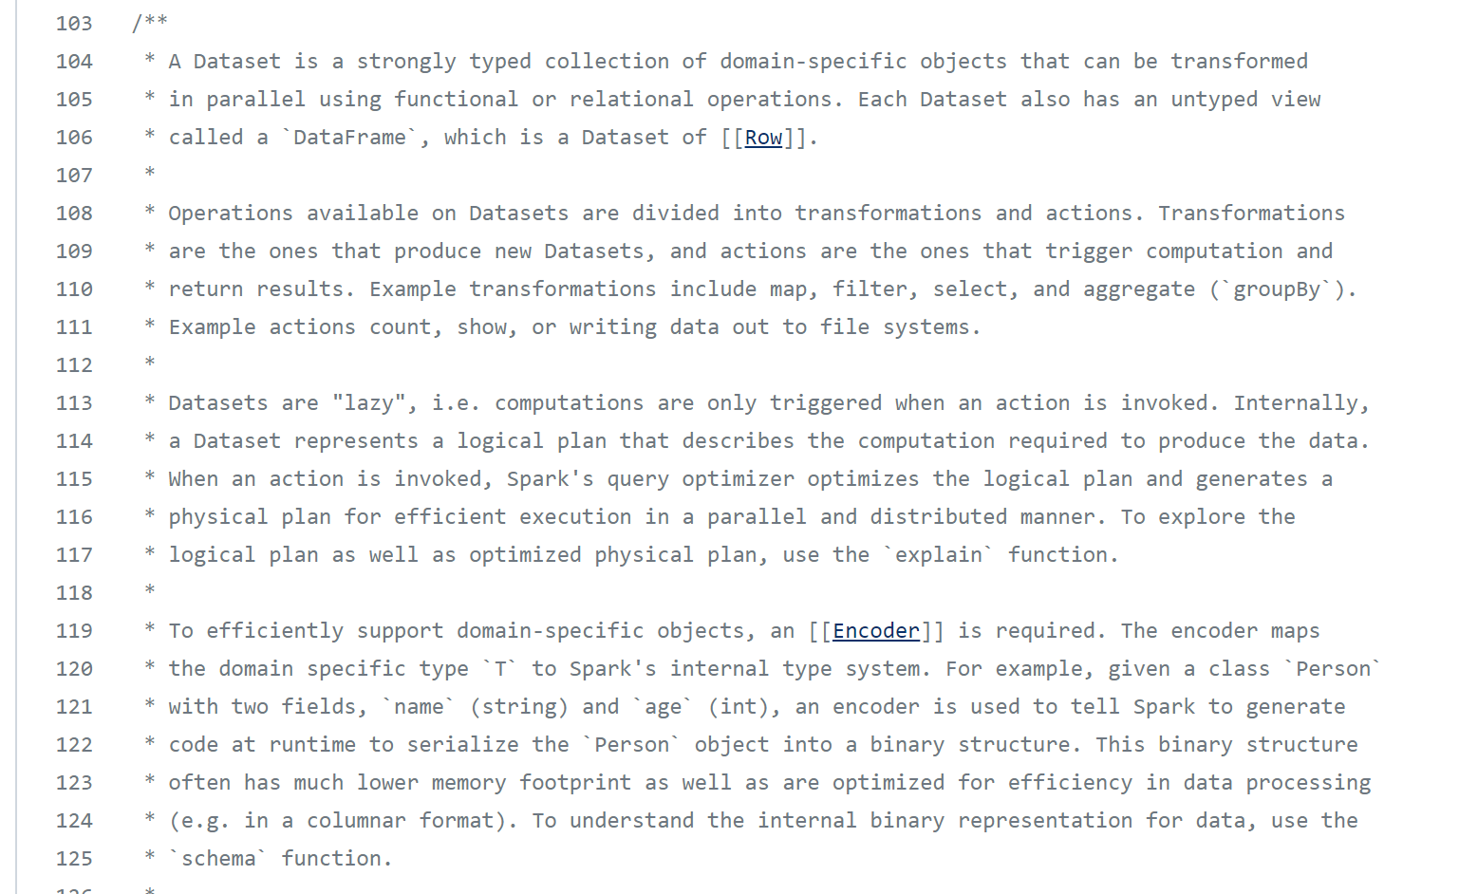
Dataset source doc

Slide 72
Dataset Doc (1/4)
A strongly typed collection of domain-specific objects
that can be transformed in parallel
using functional or relational operations
Associated untyped view: DataFrame = Dataset<Row>

Slide 73
Dataset Doc (2/4)
Operations on Datasets:
Transformations = produce new Datasets
Actions = trigger computation and return results.
Example transformations : map, filter, select, groupBy ...
Example actions : count, show, write ...
Datasets are "lazy",
i.e. computations are only triggered when an action is invoked.

Slide 74
Transformation… « produce » new Dataset NO UPDATE method Dataset are computable / « immutable »
dataset. <noSetter> ();
Dataset newDataset = dataset . <createNewWithTransform> ( … )
Example: chain method
dataset = ds .filter(..) .filter(..) .map(..) .groupBy(..),
<Result> = dataset. <action> ();
example: long result = dataset. count ();
Transform
Action

Slide 75
Dataset operations…
…
Create
ds1
Dataset<T1> ds1 = spark.read ….
Dataset<T2> ds2 = ds1.map( x -> f(x) );
Dataset<Row> ds3 = ds2.toDF();
Dataset<Row> ds4 = ds3 .filter( « col >= value ») .filter( x -> g(x) ) .map( y -> h(y) );
…
Dataset<Row> dsN = ds4 . join( dsJoined)
ds . show(); // => TRIGGER COMPUTE !!
ds2
ds3
Transform
ds4
dsJoined
dsN
Action

Slide 76
Dataset Doc (3/4)
Internally, a Dataset represents a logical plan
that describes the computation required to produce the data.
When an action is invoked,
Spark's query optimizer optimizes the logical plan
and generates a physical plan
for efficient execution in a parallel and distributed manner.
To explore.. Use ‘explain plan’

Slide 77
Internally…
Dataset<T>
SparkSession
SparkContext
QueryExecution
LogicalPlan
Encoder<T>
analyze()
AnalyzedPlan
shema()
Schema
action
ExecutedPlan
execute()
RDD

Slide 78
Dataset Doc 4/4
To efficiently support domain-specific objects, an ‘Encoder’ is required.
The encoder maps the domain specific type `T` to Spark's internal type system.
(…) to generate code at runtime
to serialize object into a much efficient binary structure (..) with lower memory footprint
(..) optimized for processing (e.g. in a columnar format).
To explore representation of data, use `schema` function.

Slide 79
Encoder<T>
Row storage
Dataset<Row>
Encoder = { objectSerializer, objectDeserializer: Expression, class}
CreateNamedStruct
fieldExpr[1]
Convert
To Spark
« Type System »
row.getAt(colIndex)
.setAt(colIndex, value)
name
type
Getter Methods
fieldExpr[2]
Columnar storage
Object
Setter Methods
fieldExpr[N]
field1, field2, … fieldN
colValues[ rowIndex]

Slide 80
Spark « Type System » DataTypes …
Annexe

Slide 81
Encoder .. Internal Expression with DataType
Annexe
Expression abstract class AST ( Abstract Syntaxic Tree )
for Sql / CodeGenerator / Java Getter-Setter
DataType
abstract class Expression
Literal
LeafExpression
UnaryExpression
BinaryExpression
CreateNamedStruct
InitJavaBean
…
CreateArray
CreateMap
(Named)
Attr, Alias, …
-, Not, new ..
+, -, *, ==, !=, <=, >=, LIKE, …
AND, OR,

Slide 82
Expression …
Annexe
Complex … INTERNAL …
( not need to understand, to use Spark)
Looks like a « SQL Compiler »
… support NOT ONLY Sql literal values,
but also NamedStruct, Array, Map, Java Objects !!!
Used internally to compile + generate code

Slide 83
Internal Spark « Type System »
Annexe
DataType
…
NullType
AtomicType
StructType
ArrayType
MapType
UserDefinedType
…
BooleanType
StringType
NumericType
DateType
Simple Value (like in SQL)
Composite Value (like in JSON)

Slide 84
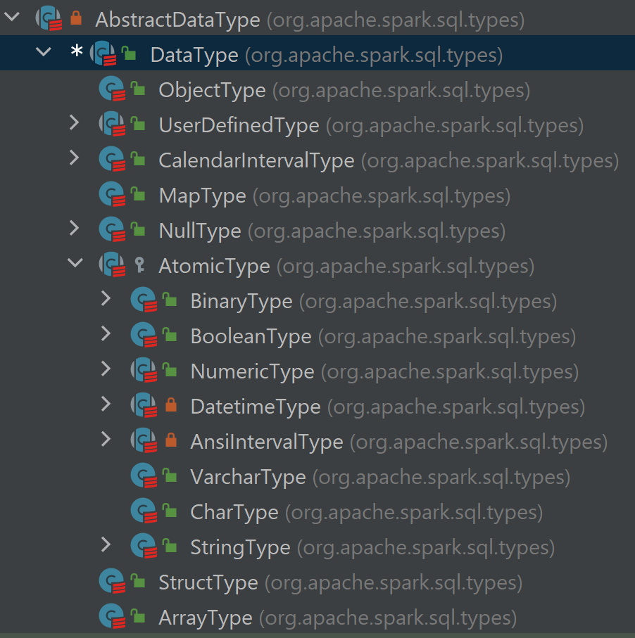
Spark DataType
Annexe

Slide 85
Hive - Spark SQL supports Struct, List, Map …
Example:
CREATE EXTERNAL TABLE `student` (
firstName string, lastName string,
practicedSports array< named_struct< name: string, numberYear: int > >,
diploma map<string, named_struct<mention: string, obtentionDate: Date > >
)

Slide 86
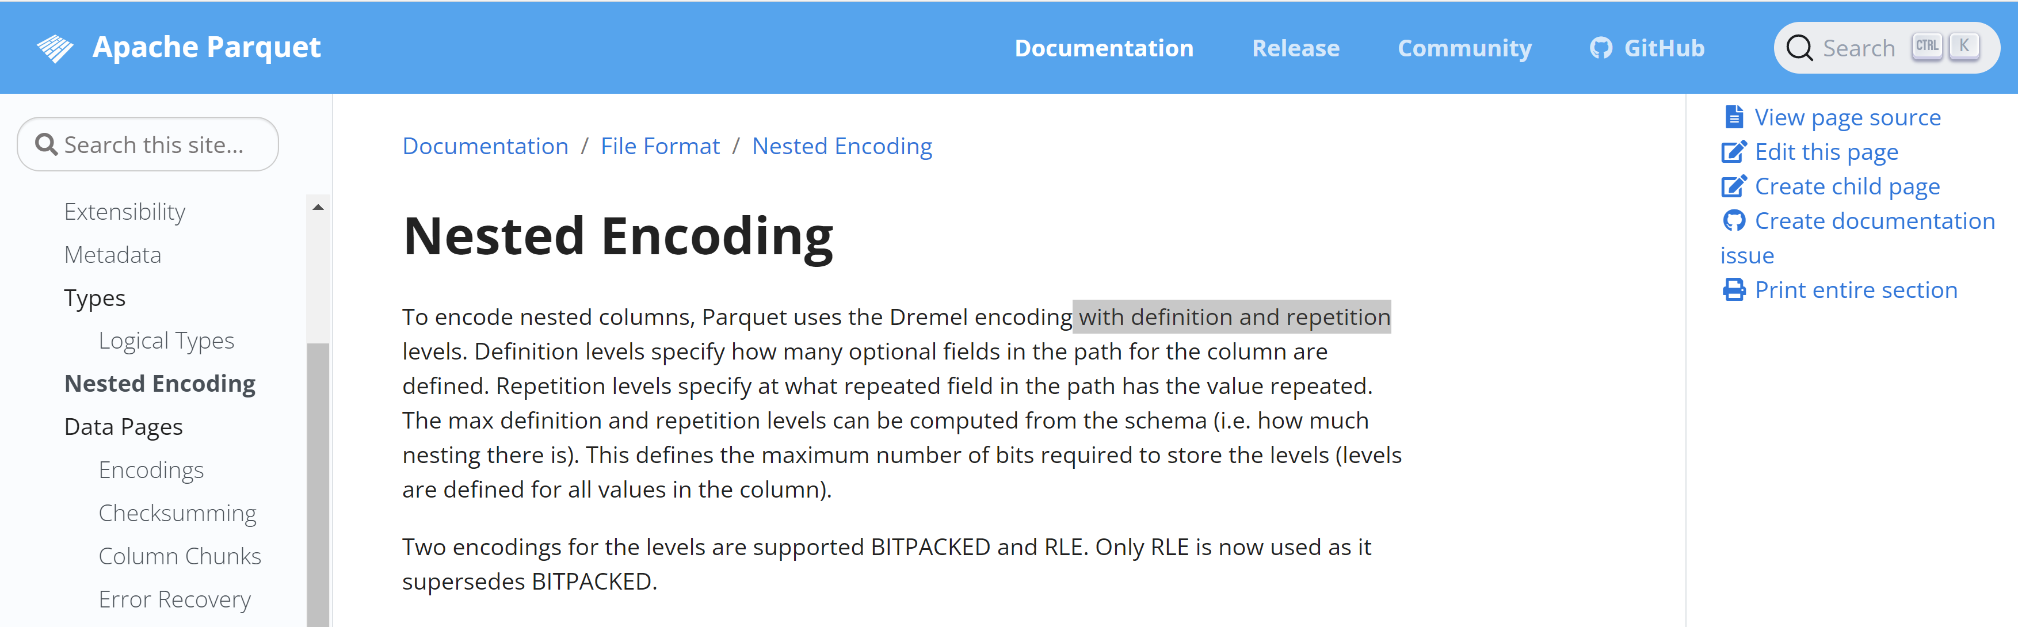


Nested fields in File Format: Parquet / Orc / Json
Parquet DataType ~ Spark DataType
Nested Encoding with « definiton » + « repetition »
DataType
JSON DataType ~ Spark DataType
(map with string only)

Slide 87
Nested Fields in Spark SQL UDF
SELECT ename, dept_list
FROM employee
+-----------+--------------+
| ename | dept_list |
+-----------+--------------+
| Tom | [20] |
| Jerry | [10,20] |
| Riley | [20,30,40] |
+-----------+--------------+
SELECT ename,
exists(dept_list, x -> x = 10) as found10
FROM employee
+-----------+--------------+
| ename | found10 |
+-----------+--------------+
| Tom | false |
| Jerry | true |
| Riley | false |
+-----------+--------------+

Slide 88
SQL Grammar Extension: « lateral view »
SELECT ename, dept_list
FROM employee
+-----------+--------------+
| ename | dept_list |
+-----------+--------------+
| Tom | [20] |
| Jerry | [10,20] |
| Riley | [20,30,40] |
+-----------+--------------+
SELECT ename, dept_id
FROM employee
LATERAL VIEW explode(dept_list) depts AS dept_id;
+---------+----------+
|ename|dept_id|
+---------+----------+
| Tom | 20 |
| Jerry | 10 |
| Jerry | 20 |
| Riley | 20 |
| Riley | 30 |
| Riley | 40 |
+---------+----------+

Slide 89
More SQL: collect_list(row) -> List
Annexe
SELECT ename, dept_list
FROM employee
+-----------+--------------+
| ename | dept_list |
+-----------+--------------+
| Tom | [20] |
| Jerry | [10,20] |
| Riley | [20,30,40] |
+-----------+--------------+
SELECT ename, collect_list(dept_id + 1) as ls
FROM ( SELECT employee
LATERAL VIEW explode(dept_list) depts AS dept_id ) GROUP BY ename
+-----------+--------------+
| ename | ls |
+-----------+--------------+
| Tom | [21] |
| Jerry | [11,21] |
| Riley | [21,31,41] |
+-----------+--------------+

Slide 90
UDF / UDAF (User Defined Aggregate Function)
Example UDF : f(x, y) { return x + y }
Function like in Math : idempotent, side-effect less, ..
! = UDAF : Aggregate / Accumulator
like in « SELECT count(..), sum(..), average(..) FROM .. GROUP BY .. »
Object instance, Class with 3 methods:
init()
add(value)
Result getResult()

Slide 91
List, Map, Struct … denormalize data, avoid Joins
ID, obj
ID, obj, obj_info1, obj_info2, …obj_infoN
obj_info1
obj_info3
obj_info2
Normalized relationnal database
Efficient DE-normalized analytics system

Slide 92
Enough for Today !
… but more to come
Questions are Welcome

Slide 93
Take Away What Did you learn ?

Slide 94
Spark-Core + …
Structured Data
Modules
DataSource Connectors
(Hadoop API)
Cluster Manager
Core
Langages Support

Slide 95
MindMap
struct
spark.read.format(« csv »)
.load(« hdfs://raw/table1 »)
.map( ..)
.repartition(3, « col1 »)
.sortWithinPartitions(« col2 ») .write.save(« hdfs://lake/table1 »
array
map
Advanced
SQL
Features
UDF, UDAF
composite
types
Union, join
Schema
Order by /sort by
Analytical query
partition over by
Dataset<Row>
TypeSystem
= Dataframe
Sample Raw-to-Lake
INSERT INTO lake_table1
SELECT /+REPARTITION(3, col1) */
*, udf_func(..)
FROM raw_table1
JOIN ..
SORT BY col2
Expression AST
Column API
Dataset
Execution
Plan
Encoder
Unified Engine
Logical
Physical
spark-core
3 == formalisms
Distributed Compute (Cluster Manager)
Distributed Storages
Langages Support
RDD
API
(SSA)
DAG
Scala
HadoopFS Api
Implems:
HDFS,
Azure,
Aws,..
Algebric
Expression
Java
R
Implems:
Yarn,Kubernetes..
Resilient
Dataset
Python
Task-Executor
Api
Distributed
Pyspark pandas

Slide 96
Next..
Lesson 1 : introduction to BigData / Hadoop cluster / Spark
Lesson 2 : this document : spark-core / spark-sql
Lesson 3 : cluster management, tuning args, deploy-mode
Lesson 4 : Advanced Spark: UI, parquet PPD, java api, spark-streaming, ..

